Slide 1
STUDENTS COLLEGE SEAT ALLOTMENT PREDICTION USING MACHINE LEARNING TECHNIQUES
By
Dhanush V.U
Charanaraj N
Deril Quadras
Jayanth S.V
Under the guidance of:
Prof. Vasudev Shahapur
Associate professor
Dept of Computer Science

Slide 2
INTRODUCTION
At present, there are sixteen IITs in India, for which admission is governed by DTE and the process is done through the cap rounds and is very confusing for student to analyze the perfect college.
The student’s are needed to verify the documents at Facilitation Centre and are supposed to give their preference list of colleges.
Then based on their Subject marks, Category, and other attributes, college is allotted to them in three or more consecutive forms.

Slide 3
Though analysis of colleges and their cut offs is required in order to get the most correct preference list.
It is very tedious job for a student to understand about the suitable colleges which provides preferred branch and to analyses it's last years cut offs in order to predict whether that he can get one of those colleges in CAP.

Slide 4
OBJECTIVE
The main objective of this project is to predict the College and Department allocation for the students based on their marks and skills.

Slide 5
PROBLEM STATEMENT
Most of the students make mistakes in their preference list due to lack of knowledge, improper and incorrect analysis of colleges and insecure predictions.
Hence those students regret after what they get the college after allotment.
Our system is dedicated to predict seat allotment based on marks scored ,memory capability score ,aptitude test and suggested job role etc.

Slide 6
LITERATURE SURVEY
Title | Authors | Description
Predictive Models of Student College Commitment Decisions Using Machine Learning. | Kandapriya Basu, Treena Basu, Ron Buckmire and Nishu Lal. | Institutions could use machine learning algorithms to improve the accuracy of their estimates of entering class sizes, thus allowing more optimal allocation of resources and better control over net tuition revenue.
Machine Learning to Predict College Course Success | Anthony Dalton , Justin Beer , Sriharshasai Kommanapalli , James S. Lanich | The model will benefit first time college students by accurate placement into courses they will be able to successfully complete.

Slide 7
SYSTEM REQUIREMENTS
Software Used:
Python.
Anaconda Framework.
Jupyter Notebook IDE.

Slide 8
PROPOSED SYSTEMS
Today, most students make mistakes in their preference list due to lack of knowledge, improper and incorrect analysis of colleges and insecure predictions.
Hence repent and regret after allotment. Our project will solve the general issue of the student community by using machine learning technology.
In this system using Random Forest and Decision Tree machine learning classification algorithm.

Slide 9
METHODOLOGY
The system has several steps like Data Acquisition and Preprocessing, Feature Selection and Data Preparation, Model Construction and Model Training, and Model Validation and Result Analysis.
We are using Machine Learning Algorithms such as Decision Tree and Random Forest to test our dataset.
First the data is preprocessed to remove all errors and then split into training and testing dataset.
The training dataset is then fit into the model in order to predict the values then the trained model is again tested and accuracy is calculated.

Slide 10
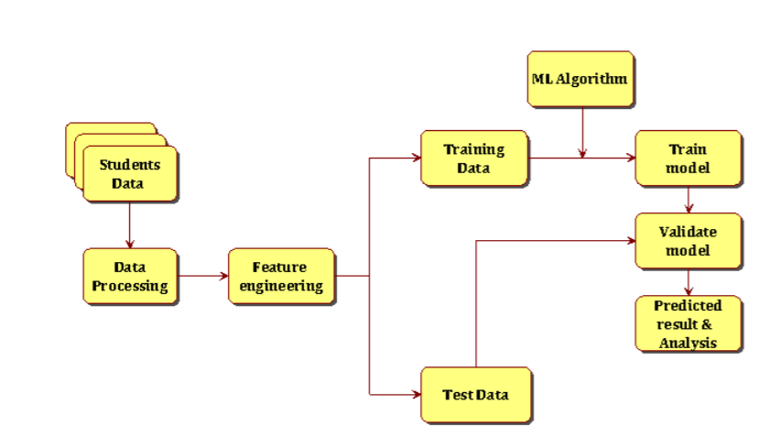
SYSTEM ARCHITECTURE

Slide 11
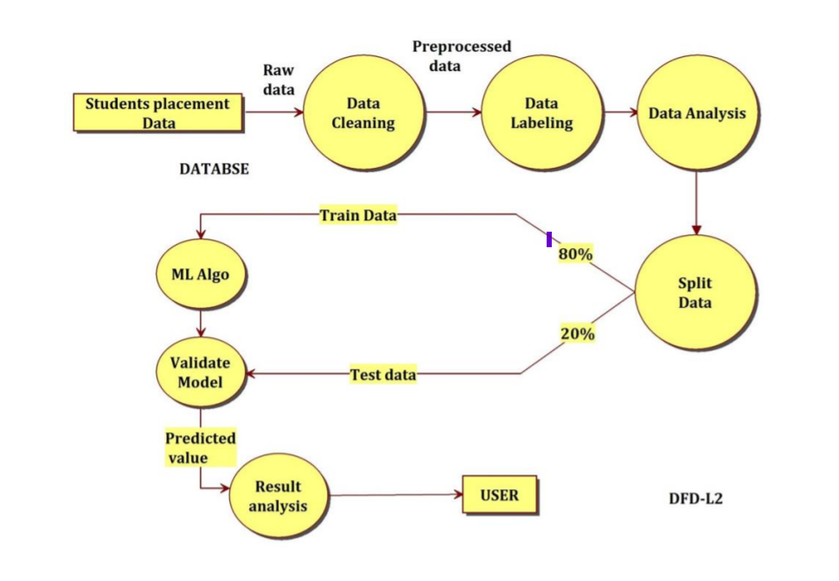
DATA FLOW DIAGRAM

Slide 12
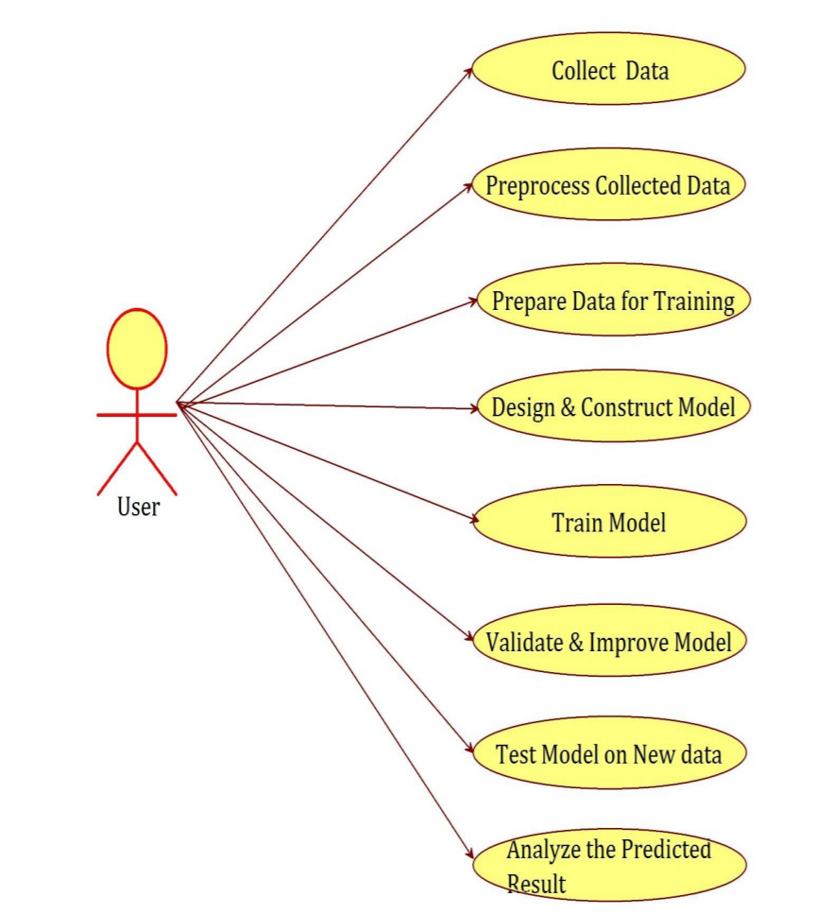
USE CASE DIAGRAM

Slide 13
ALGORITHM
It begins with the original set S as the root node.
On each iteration of the algorithm, it iterates through the very unused attribute of the set S and calculates Entropy(H) and Information gain(IG) of this attribute.
It then selects the attribute which has the smallest Entropy or Largest Information gain.

Slide 14
Conti..
The set S is then split by the selected attribute to produce a subset of the data.
The algorithm continues to recur on each subset, considering only attributes never selected before.
A Random Forest is a meta estimator that fits a number of decision tree classifiers on various sub-samples of the dataset.

Slide 15
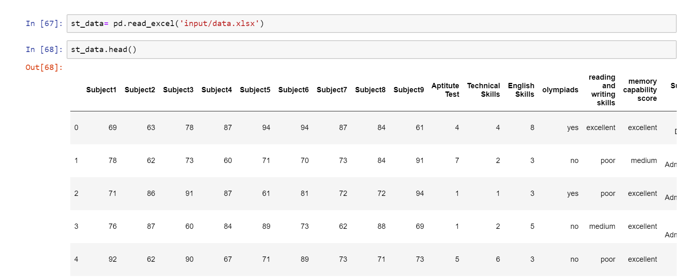
IMPLEMENTATON
Loading Dataset

Slide 16
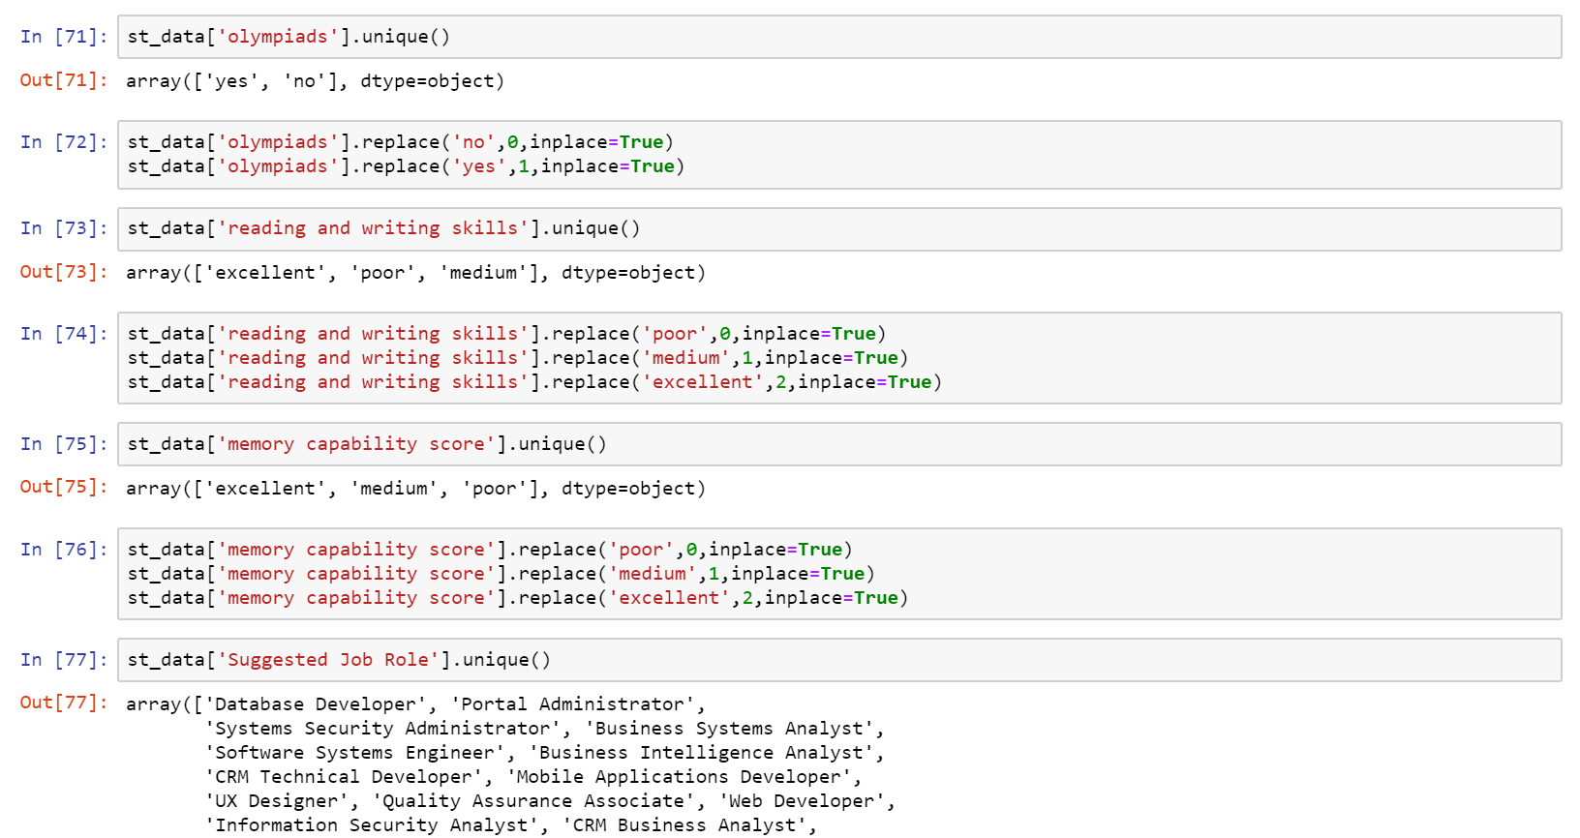
Data Preprocessing

Slide 17
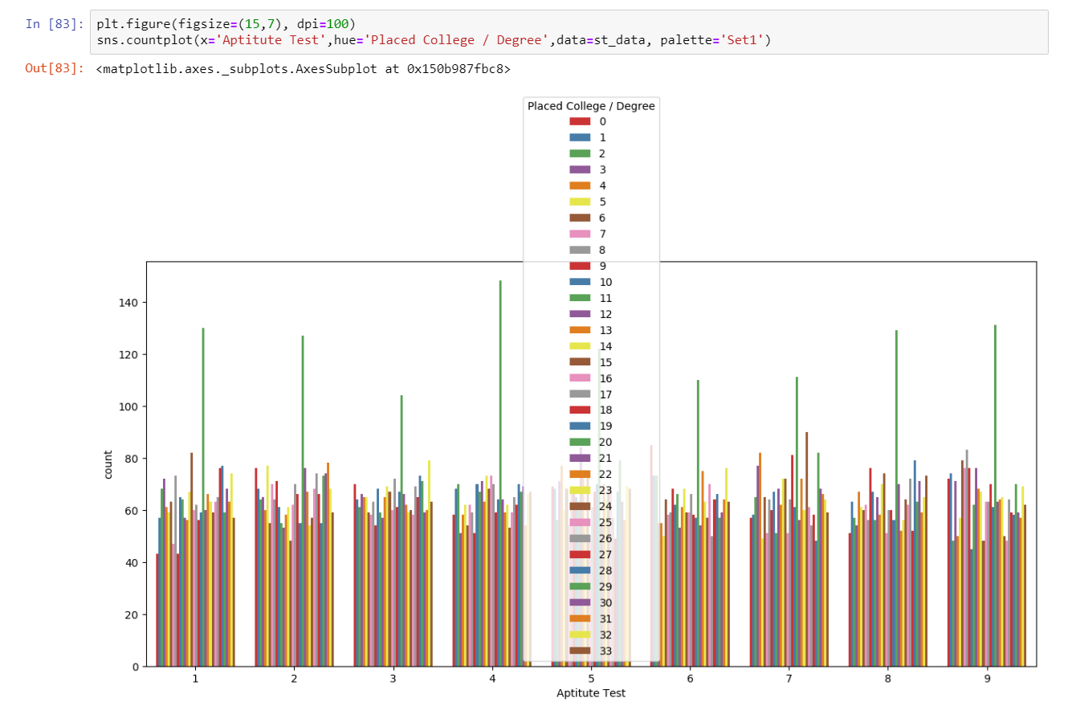
Data Analysis

Slide 18
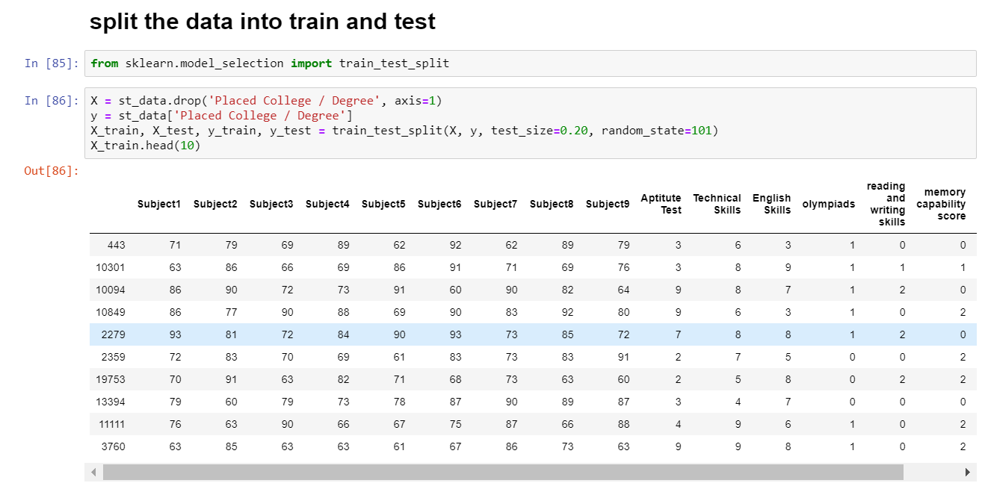
Splitting dataset into train and test

Slide 19
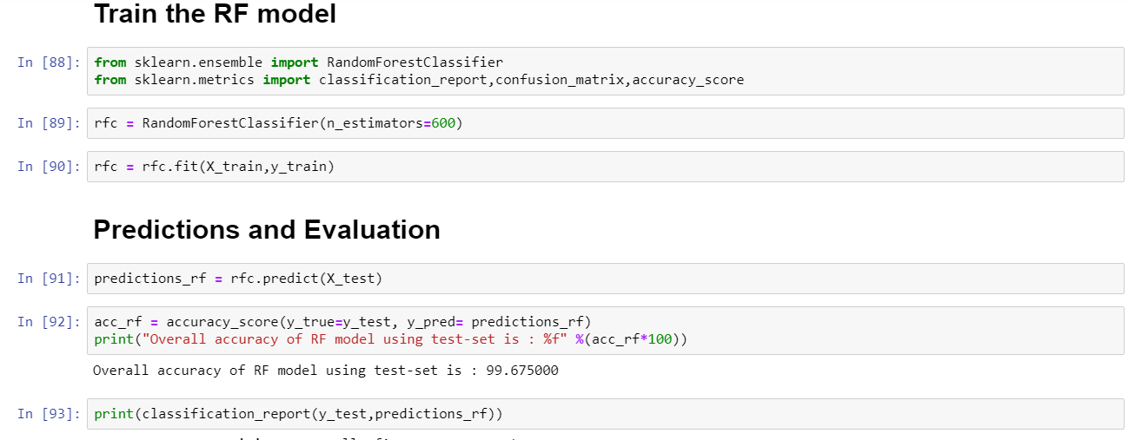

Training the Random forest model and Prediction and Evaluation

Slide 20
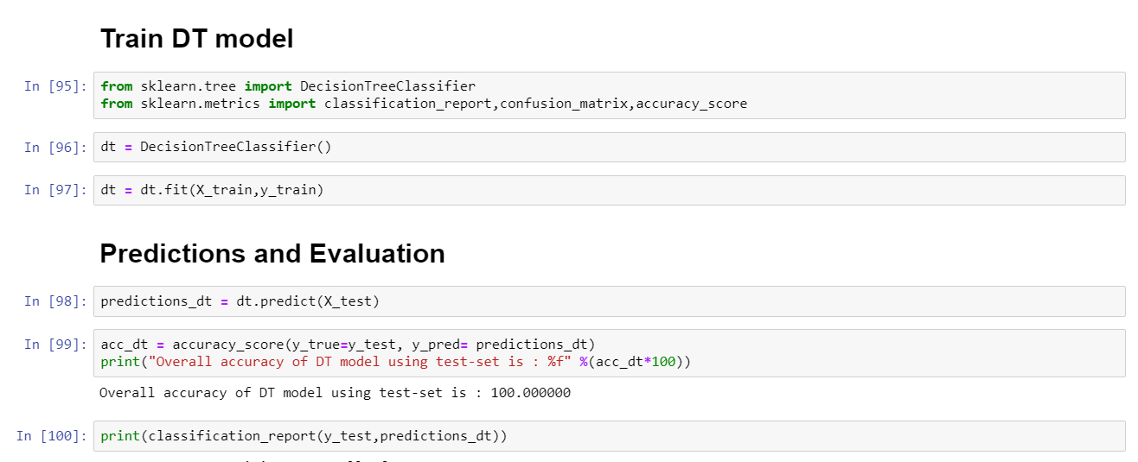

Training the Decision Tree model and Prediction and Evaluation

Slide 21
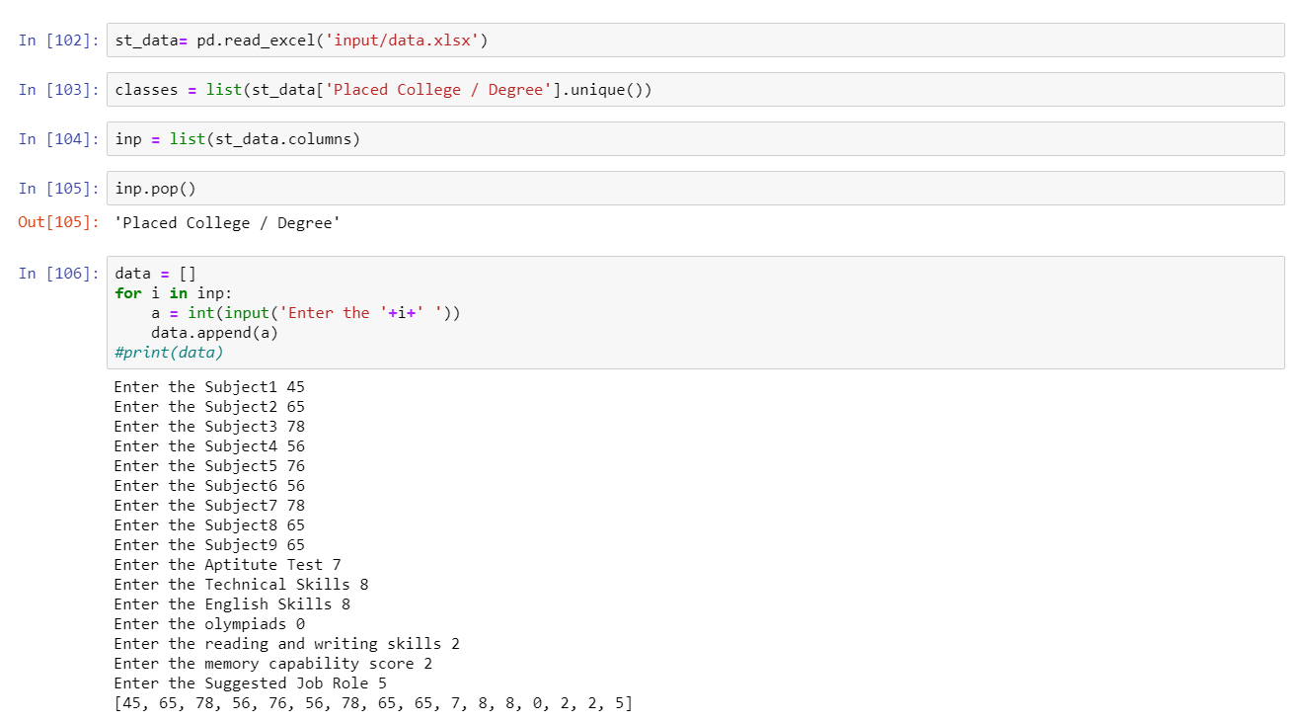
Testing the model for user input

Slide 22
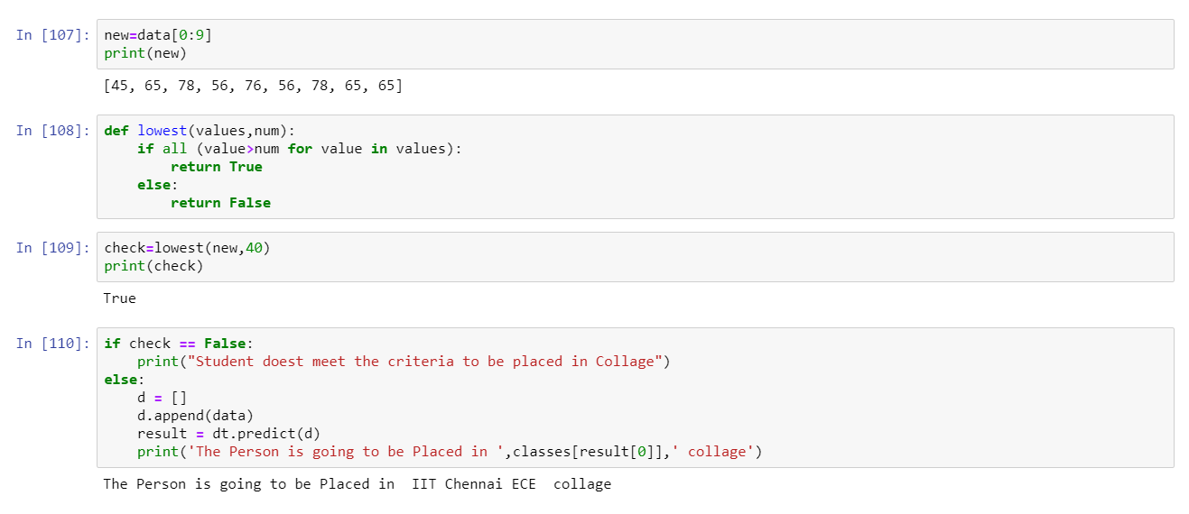
Output

Slide 23
CONCLUSION
We find that the best model for predicting the success, whether a student will pass their college course with a better marks of a student differs between our datasets best prediction model.
Random Forest with an accuracy of 99.82% and better precision, recall, and support values than the other models.
Using Decision tree algorithm at an accuracy of 100% and likewise better precision, recall, and support values than the other models.

Slide 24
REFERENCES
“Predictive Models of Student College Commitment Decisions Using Machine Learning” by Kandapriya Basu, Treena Basu.
“Machine Learning to Predict College Course Success” by Anthony Dalton, Justin Beer.

Slide 25
THANK YOU

